Slide 1
Top 50 ggplot2 Visualizations - The Master List
An effective chart is one that:
Conveys the right information without distorting facts.
Is simple but elegant. It should not force you to think much in order to get it.
Aesthetics supports information rather that overshadow it.
Is not overloaded with information.
Primarily, there are 8 types of objectives you may construct plots.
So, before you actually make the plot, try and figure what findings and relationships you would like to convey or examine through the visualization. Chances are it will fall under one (or sometimes more) of these 8 categories.
Correlation
Scatterplot
Scatterplot With Encircling
Jitter Plot
Counts Chart
Bubble Plot
Animated Bubble Plot
Marginal Histogram / Boxplot
Correlogram
Deviation
Diverging Bars
Diverging Lollipop Chart
Diverging Dot Plot
Area Chart
Pyramid

Slide 2
Ranking
Ordered Bar Chart
Lollipop Chart
Dot Plot
Slope Chart
Dumbbell Plot
Distribution
Histogram
Density Plot
Box Plot
Dot + Box Plot
Tufte Boxplot
Violin Plot
Population Composition
Waffle Chart
Pie Chart
Treemap
Bar Chart

Slide 3
Change
Time Series Plots
From a Data Frame
Format to Monthly X Axis
Format to Yearly X Axis
From Long Data Format
From Wide Data Format
Stacked Area Chart
Calendar Heat Map
Slope Chart
Seasonal Plot
Groups
Dendrogram
Clusters
Spatial
Open Street Map
Google Road Map
Google Hybrid Map

Slide 4
Scatter plot With Encircling
When presenting the results, sometimes I would encirlce certain special group of points or region in the chart
This can be conveniently done using the geom_encircle() in ggalt package.
Within geom_encircle(), set the data to a new dataframe that contains only the points (rows) or interest.
Moreover, You can expand the curve so as to pass just outside the points. The color and size (thickness) of the curve can be modified as well.

Slide 5
# install 'ggalt' pkg
# devtools::install_github("hrbrmstr/ggalt")
options(scipen = 999)
library(ggplot2)
library(ggalt)
midwest_select <- midwest[midwest$poptotal > 350000 &
midwest$poptotal <= 500000 &
midwest$area > 0.01 &
midwest$area < 0.1, ]

Slide 6
# Plot
# draw points
ggplot(midwest, aes(x=area, y=poptotal)) + geom_point(aes(col=state, size=popdensity)) +
# draw smoothing line
geom_smooth(method="loess", se=F) + xlim(c(0, 0.1)) + ylim(c(0, 500000)) +
+ # encircle
geom_encircle(aes(x=area, y=poptotal), data=midwest_select, color="red", size=2, expand=0.08) labs(subtitle="Area Vs Population", y="Population", x="Area", title="Scatterplot + Encircle", caption="Source: midwest")

Slide 7
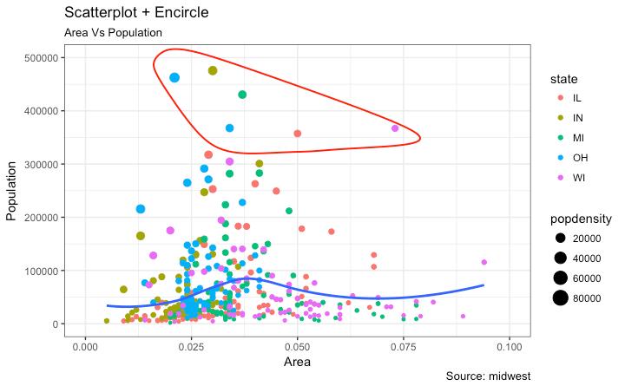

Slide 8
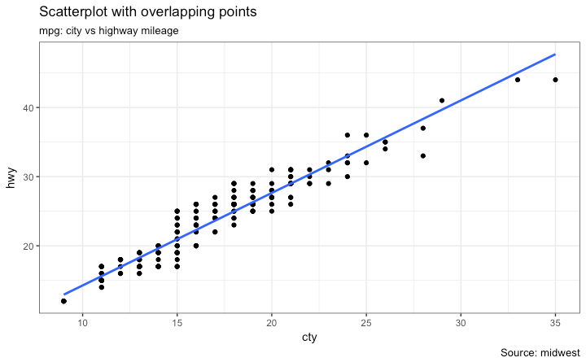
Jitter Plot: Let’s look at a new data to draw the scatterplot. This time, I will use the mpg dataset to plot city mileage (cty) vs highway mileage (hwy). # load package and data library(ggplot2) data(mpg, package="ggplot2") # alternate source: "http://goo.gl/uEeRGu") # pre-set the bw theme. theme_set(theme_bw()) # Scatterplot g g <- ggplot(mpg, aes(cty, hwy)) + geom_point() + geom_smooth(method="lm", se=F) + labs(subtitle="mpg: city vs highway mileage", y="hwy", x="cty", title="Scatterplot with overlapping points", caption="Source: midwest")

Slide 9
What we have here is a scatterplot of city and highway mileage in mpg dataset.
We have seen a similar scatterplot and this looks neat and gives a clear idea of how the city mileage (cty) and highway mileage (hwy) are well correlated.
But, this innocent looking plot is hiding something. Can you find out?
dim(mpg)
The original data has 234 data points but the chart seems to display fewer points.
What has happened?
This is because there are many overlapping points appearing as a single dot.
The fact that both cty and hwy are integers in the source dataset made it all the more convenient to hide this detail.
So just be extra careful the next time you make scatterplot with integers.
So how to handle this?
There are few options.
We can make a jitter plot with jitter_geom().
As the name suggests, the overlapping points are randomly jittered around its original position based on a threshold controlled by the width argument.

Slide 10
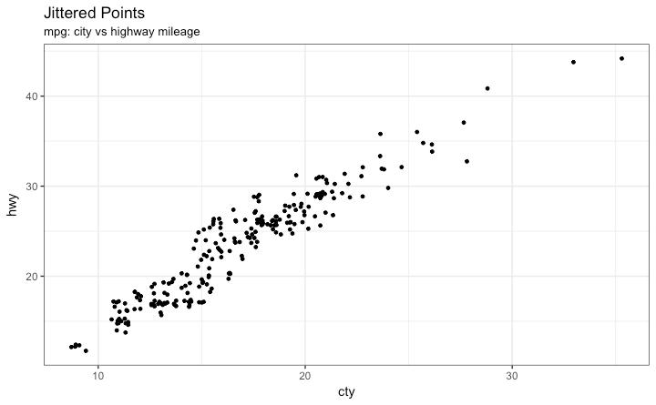
# load package and data library(ggplot2) # mpg data(mpg, package="ggplot2") # Scatterplot <- read.csv("http://goo.gl/uEeRGu") # pre-set the bw theme theme_set(theme_bw()) g <- ggplot(mpg, aes(cty, hwy)) g + geom_jitter(width = .5, size=1) + labs ( subtitle ="mpg: city vs highway mileage", y="hwy", x="cty", title="Jittered Points")

Slide 11
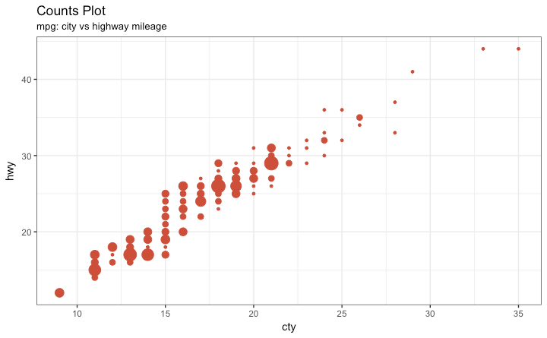
Counts Chart: The second option to overcome the problem of data points overlap is to use what is called a counts chart. Where ever there is more points overlap, the size of the circle gets bigger. # load package and data library(ggplot2) # mpg data(mpg, package="ggplot2") # Scatterplot <- read.csv("http://goo.gl/uEeRGu") # pre-set the bw theme. theme_set(theme_bw()) g <- ggplot(mpg, aes(cty, hwy)) g + geom_count(col="tomato3", show.legend=F) + labs(subtitle="mpg: city vs highway mileage", y="hwy", x="cty", title="Counts Plot")

Slide 12
Bubble plot
While scatterplot lets you compare the relationship between 2 continuous variables,
bubble chart serves well if you want to understand relationship within the underlying groups based on:
A Categorical variable (by changing the color) and
Another continuous variable (by changing the size of points).
In simpler words,
bubble charts are more suitable if you have 4-Dimensional data
where two of them are numeric (X and Y)
one other categorical (color) and another numeric variable (size).
The bubble chart clearly distinguishes the range of displ between the manufacturers and how the slope of lines-of-best-fit varies, providing a better visual comparison between the groups.
# load package and data
library(ggplot2)
# mpg data(mpg, package="ggplot2")
<- read.csv("http://goo.gl/uEeRGu")
# Scatterplot mpg_select <- mpg[mpg$manufacturer %in% c("audi", "ford", "honda", "hyundai"), ]
# pre-set the bw theme. theme_set(theme_bw())
g <- ggplot(mpg_select, aes(displ, cty)) + labs(subtitle="mpg: Displacement vs City Mileage", title="Bubble chart") g + geom_jitter(aes(col=manufacturer, size=hwy))+geom_smooth(aes(col=manufacturer), method="lm", se=F)

Slide 13
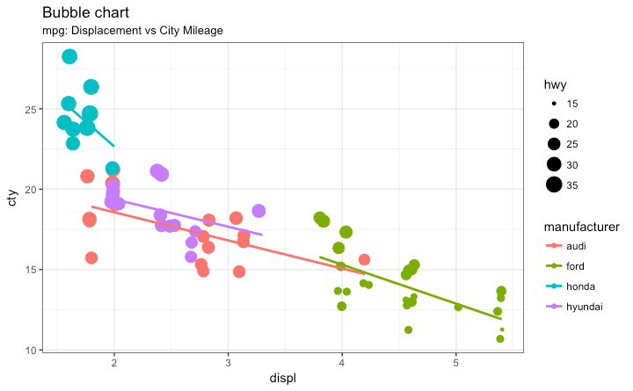

Slide 14
Animated bubble chart:
can be implemented using the gganimate package.
It is same as the bubble chart, but, you have to show how the values change over a fifth dimension (typically time).
The key thing to do is to set the aes(frame) to the desired column on which you want to animate.
Rest of the procedure related to plot construction is the same.
Once the plot is constructed, you can animate it using gganimate() by setting a chosen interval.
#Source: https://github.com/dgrtwo/gganimate
# install.packages("cowplot")
# a gganimate dependency
# devtools::install_github("dgrtwo/gganimate")
library(ggplot2)
library(gganimate)
library(gapminder)
theme_set(theme_bw()) # pre-set the bw theme.
g <- ggplot(gapminder, aes(gdpPercap, lifeExp, size = pop, frame = year)) + geom_point() + geom_smooth(aes(group = year), method = "lm", show.legend = FALSE) + facet_wrap(~continent, scales = "free") + scale_x_log10()
# convert to log scale
gganimate(g, interval=0.2)

Slide 16
Correlogram: Correlogram let’s you examine the corellation of multiple continuous variables present in the same dataframe. This is conveniently implemented using the ggcorrplot package.
#devtools::install_github("kassambara/ggcorrplot")
library(ggplot2)
library(ggcorrplot) # Correlation matrix
data(mtcars)
corr <- round(cor(mtcars), 1) # Plot
ggcorrplot(corr, hc.order = TRUE, type = "lower", lab = TRUE, lab_size = 3, method="circle", colors = c ( “ tomato 2", "white", "springgreen3"), title = “ Correlogram of mtcars", ggtheme=theme_bw)

Slide 17
